Slide 1
Glossary Blockchain and AI

Slide 2
Crawl Data
01
Data Visualization
Content
02
Find Glossary
03
Search and collect data from websites about terminology
Overview and check data
Write code that has obtained the terms

Slide 3
01
Crawl Data

Slide 4
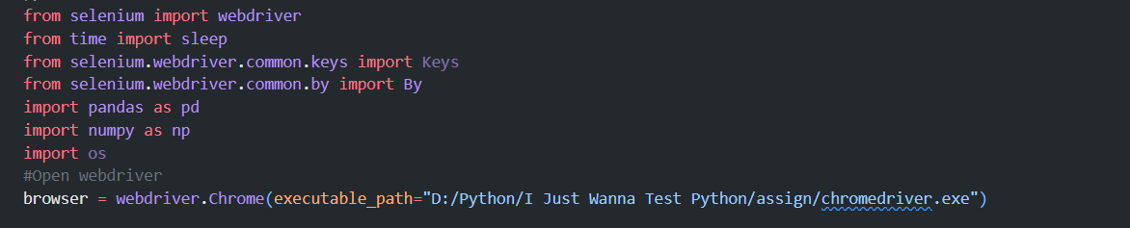
Libraries
Pandas
Numpy
Selenium

Slide 5
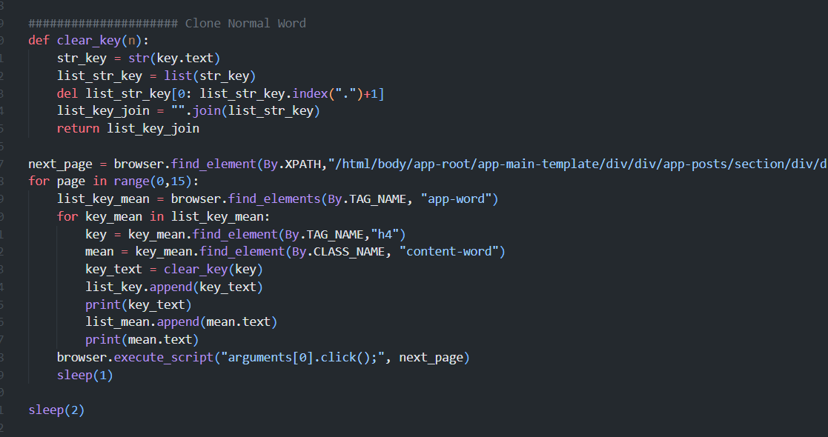
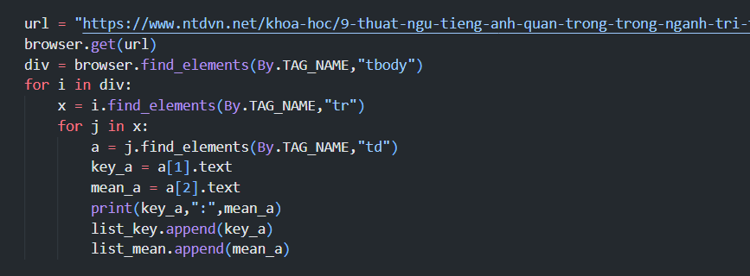
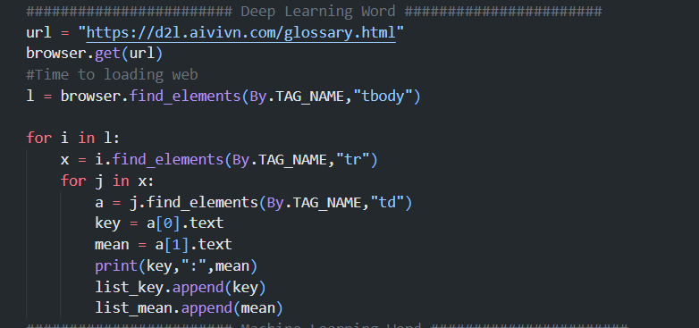
Perform
Blockchain
Websites
search for web pages that contain the term about
IT
AI
Deep Learning

Slide 6
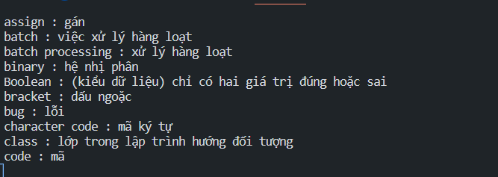
Result
All collected data will be saved to excel file

Slide 7
02
Data Visualization

Slide 8
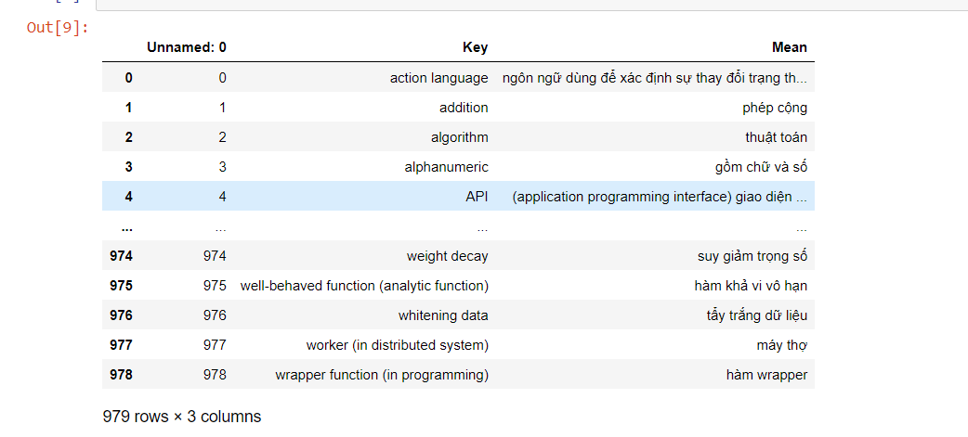
Data Visualization
Data set
This is the saved data, but since the data has been edited at the time of collection, the displayed data does not have many errors
.

Slide 9
03
Find Glossary

Slide 10
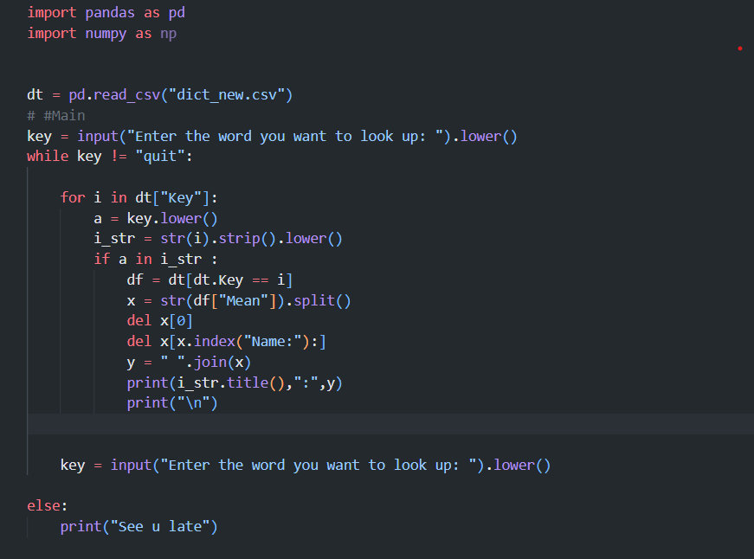
Perform
Code
Libraries
”

Slide 11
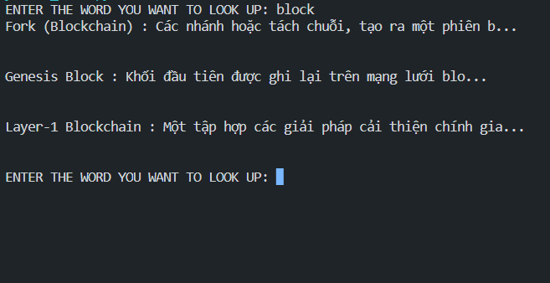
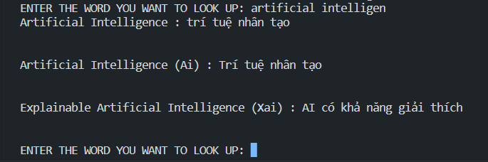
Result

Slide 12
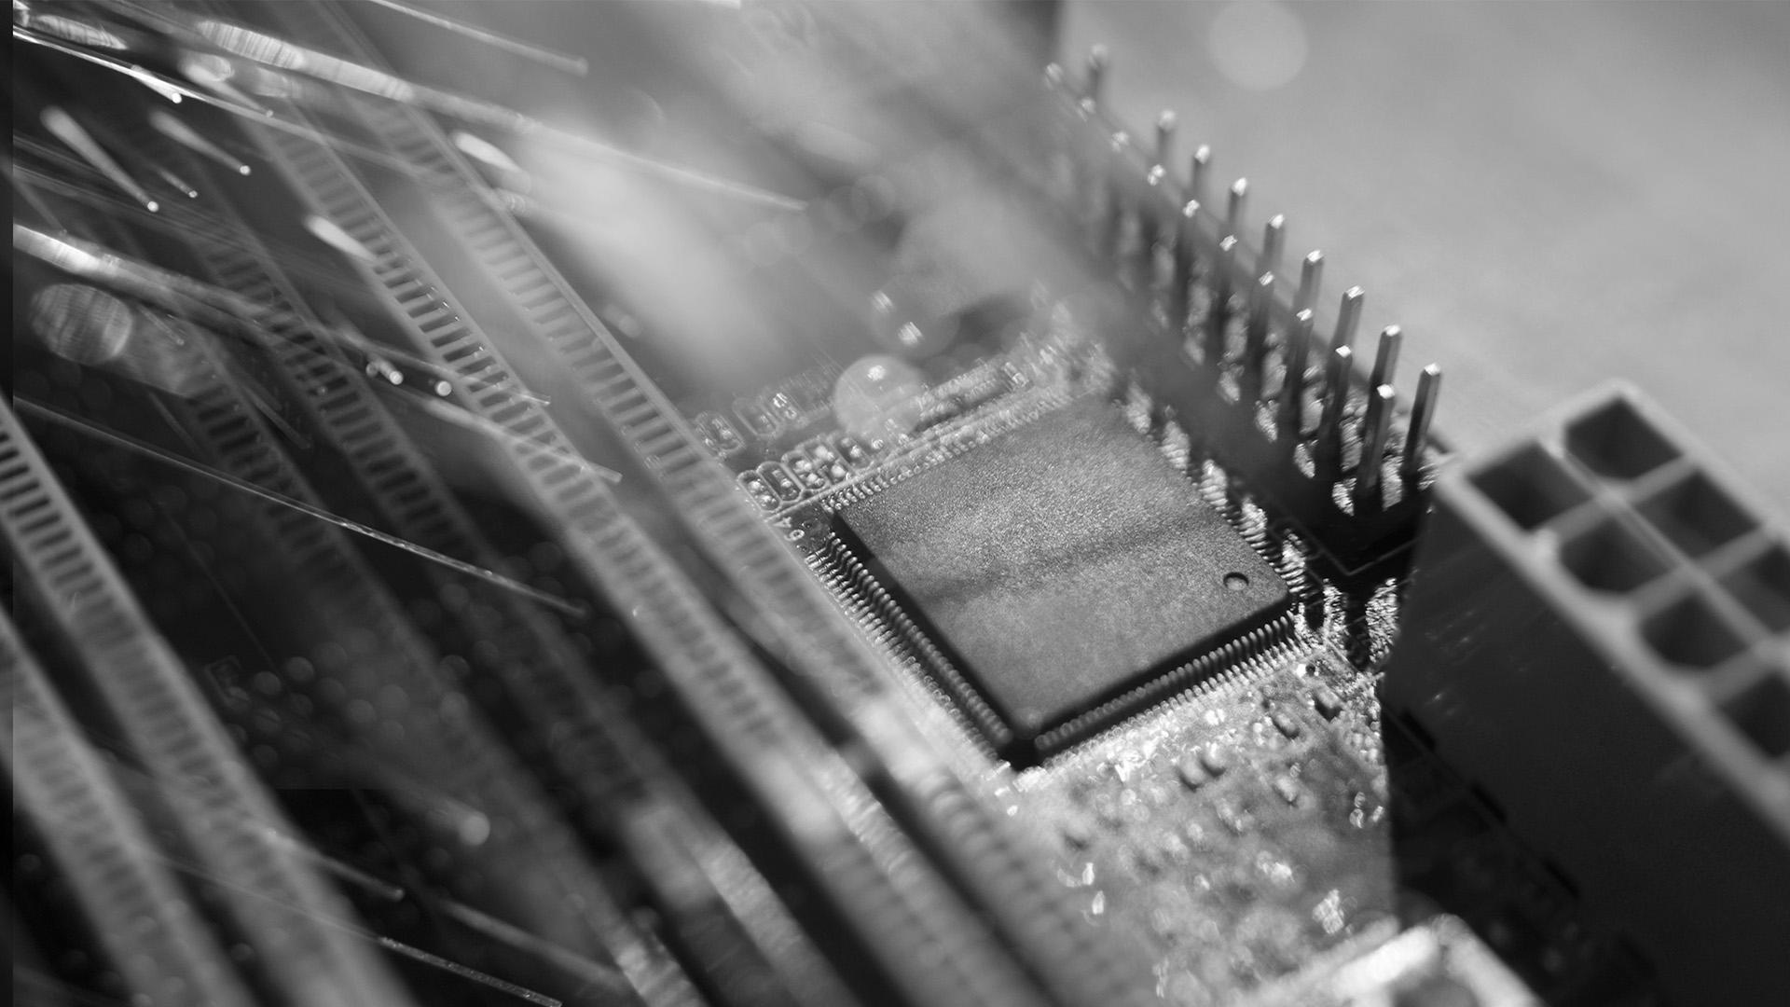
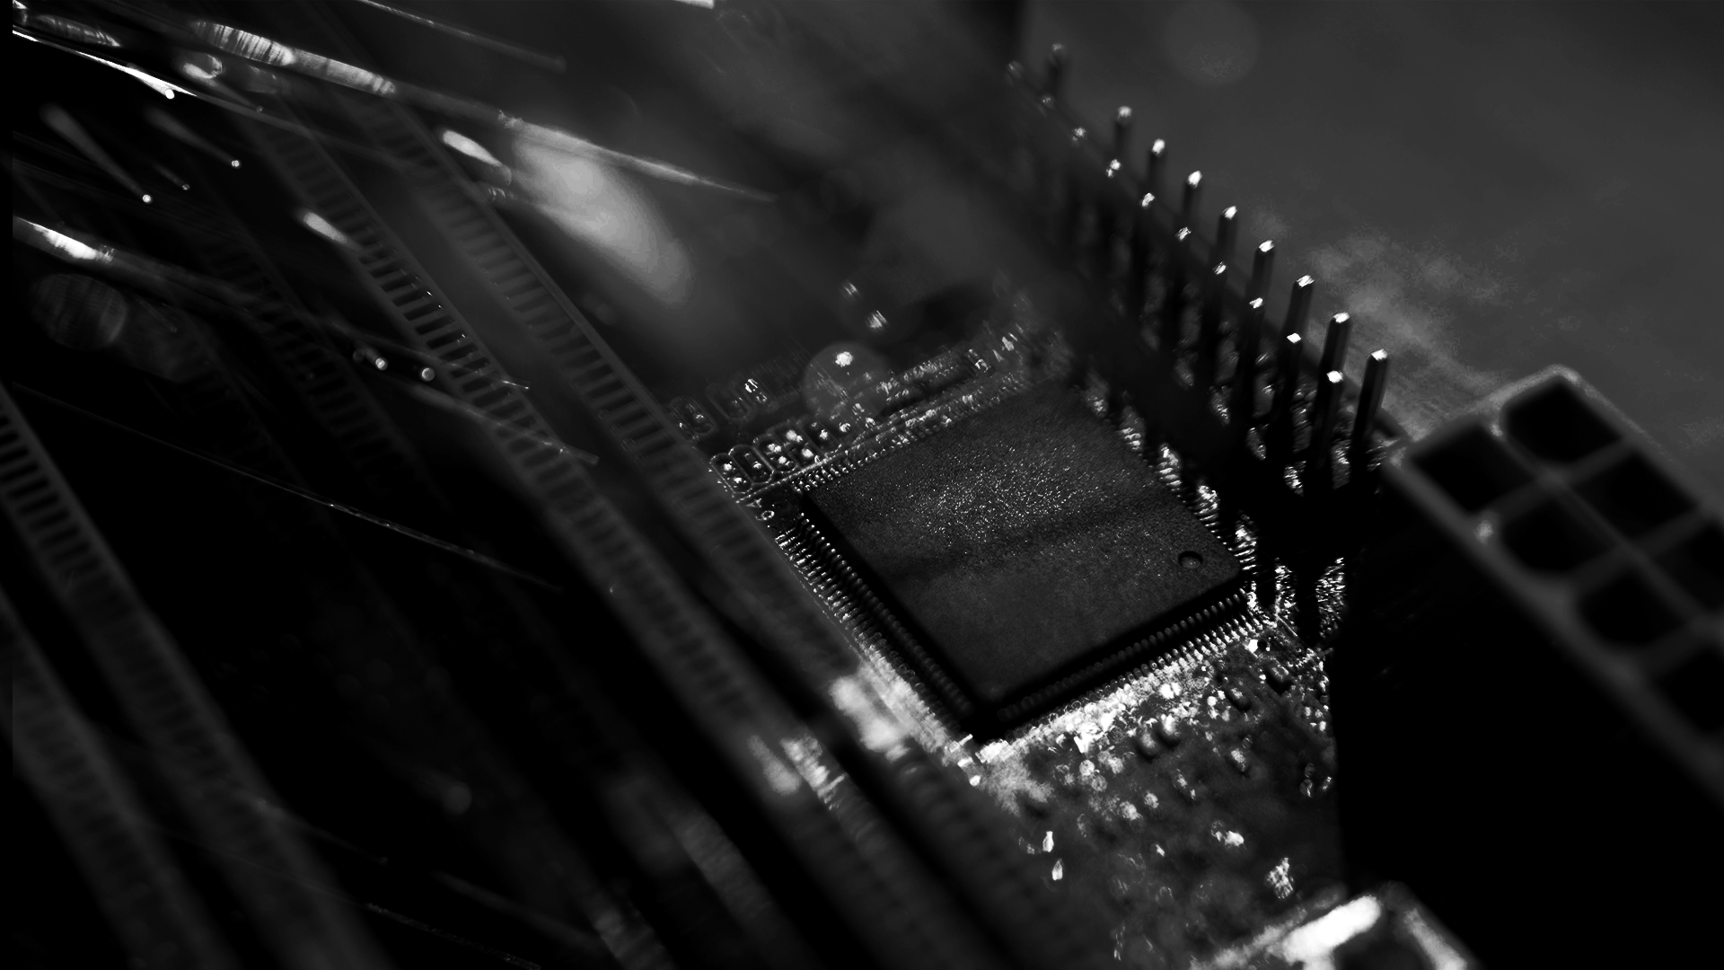
Thanks for Watching

